Slide 1

Gesture-based volume control
SRM Institute of Science and Technology
College of Engineering & Technology | School of Computing
Department of Computing Technologies
18CSC305J Artificial Intelligence – Mini Project
Team Members
1.RA2111003010314 -Aditi
2.RA2111003010320-Kamya Gupta
3.RA2111003010327-Isha Singh

Slide 2
Abstract
Challenge: Traditional volume controls (buttons, touchscreens) are inconvenient and disrupt user focus.
Innovation: This project proposes AI-based volume control using hand gestures for a hands-free, intuitive interface.
Technology:
* Camera captures video/image data.
* Computer vision algorithms powered by AI identify pre-defined hand gestures (e.g., pinching for decrease, spreading for increase).
Benefits:
* More natural and interactive user experience.
Applications:
* Smart TVs
* Gaming consoles
* Virtual reality (and potentially others)
Future Work:
* Enhance accuracy of gesture recognition.
* Improve robustness in different lighting conditions.
* Explore multi-hand gestures for expanded functionalities.

Slide 3
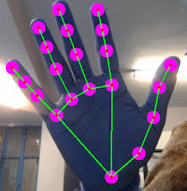

Introduction
Gesture-based volume control is a cutting-edge technology that enhances user interaction with audio devices. This project explores the innovative approach of utilizing gesture detection to manipulate audio volume settings.
By employing sensors and computer vision techniques, users can seamlessly adjust volume levels through hand movements or gestures, eliminating the need for physical buttons or voice commands.
This intuitive interface offers a hands-free and tactile method for controlling audio devices, enhancing accessibility and convenience. The abstract delves into the underlying technology, discussing the sensors, algorithms, and machine learning models employed for accurate gesture recognition.

Slide 4
Use Cases
1.Smart TVs: Control volume while relaxing on the couch without reaching for the remote.
2.Gaming Consoles: Adjust volume during intense gameplay without pausing or taking your eyes off the screen.
3.Virtual Reality (VR): Maintain immersion in VR experiences by manipulating volume with hand gestures within the virtual environment.
4.Smartphones: Discreetly adjust volume in public settings (meetings, libraries) using hand gestures near the phone.
5.Accessibility: Provide a hands-free volume control option for users with physical limitations.

Slide 5
Challenges / Motivation
1. Gesture Recognition Accuracy:
- Challenge: Ensuring accurate recognition of hand gestures in diverse conditions.
- Motivation: Enhancing user experience and reliability of volume control.
2. User Adoption and Familiarity:
- Challenge: Encouraging user adaptation to gesture-based controls.
- Motivation: Providing intuitive gestures and clear instructions for ease of use.
3. Accessibility and Inclusivity:
- Challenge: Ensuring accessibility for all users, including those with disabilities.
- Motivation: Promoting inclusivity through alternative control methods and consideration of diverse needs.
4. Gesture Standardization:
- Challenge: Establishing standardized gestures across devices for consistency.
- Motivation: Simplifying user interaction and enhancing interoperability.
5. Privacy and Security Concerns:
- Challenge: Addressing privacy and security risks associated with gesture data.
- Motivation: Implementing robust security measures to build user trust.
6. User Interface Design:
- Challenge: Designing an intuitive interface for gesture control.
- Motivation: Enhancing user satisfaction and interaction with audio devices.

Slide 6
Problem Statement
Problem Statement:
Traditional volume control methods (buttons, touchscreens) hinder a seamless user experience. They disrupt focus (reaching for controls), limit accessibility (physical limitations), and break immersion (VR environments). This project proposes an AI-based solution using hand gesture recognition to create a more natural, hands-free, and universally accessible volume control interface for various applications. However, challenges remain in ensuring accurate gesture recognition despite variations in user posture, lighting, and background. Additionally, balancing real-time performance with the computational demands of AI algorithms requires careful consideration.

Slide 7
Literature Survey
Author(s) | Title | Dataset | Method | Remarks
Aayush Gupta | A Hand Gesture Volume Control application made using OpenCV & MediaPipe | Not specified | Hand tracking with OpenCV and MediaPipe, distance between thumb and index finger for volume control | Basic implementation using hand landmarks
Pratham Bhatnagar | Gesture Volume Control Using OpenCV and MediaPipe | Not specified | Hand tracking with OpenCV and MediaPipe, distance between thumb and index finger for volume control | Offers configuration options for hand detection
Ijisrt (Authors not specified) | Volume Control using Gestures | Not specified | Hand gesture recognition with OpenCV, fingertip positions for volume control | Discusses the concept and basic functionalities
M.A. Zarandian et al. | Hand Gesture Recognition for Volume Control | https://ieeexplore.ieee.org/document/6392552/ | Convolutional Neural Networks (CNNs) for hand gesture recognition, various hand shapes for volume control | Introduces deep learning approach for robust gesture recognition
Stefan Kreisl et al. | A Novel 3D Hand Posture Interface for Continuous Air Drumming and Volume Control | https://dl.acm.org/doi/abs/10.1145/3472749.3474759 | 3D hand posture estimation, orientation and position for volume control | Explores using 3D data for more intuitive control
Enrico Rukoz et al. | Mid-Air Gestural Interaction for Volume Control in Public Displays | https://buildings.honeywell.com/content/dam/hbtbt/en/documents/downloads/ACM-Data-Sheet.pdf | Depth camera and fingertip tracking, finger swiping for volume control | Focuses on interaction with public displays

Slide 8
Existing System / Work
Such a system can provide users with a seamless and hands-free way to control audio playback devices, enhancing user convenience and accessibility.
Gesture Recognition:
The core functionality of the system involves recognizing specific hand movements made by the user.

Slide 9
Existing System / Work
Real-time Tracking:
The system utilizes computer vision techniques to track the user's hand movements in real-time. This tracking is done using cameras, such as webcams, integrated into the computer. Algorithms process the video feed to locate and analyze the hand's position and orientation.
Volume Control:
Once the system recognizes a particular gesture, it translates it into a corresponding volume control command. For example, increasing the distance between thumb and index finger increases the volume, while decreasing the distance decreases it.

Slide 10
Proposed System / Work
It also highlights the potential applications, such as in:
Increasing screen brightness
Smart homes
Automotive systems
Wearable devices
Smart driving solutions to enable driver safety based on gesture-detection.
Surgical Procedures: surgeons could use hand gestures to control medical equipment/devices, thereby minimizing the need to touch surfaces during surgery thereby ensuring a sterile procedure.

Slide 11
Proposed System / Work
Detecting early signs of Autism: Unusual hand and finger mannerisms in children can be detected – e.g. finger-flicking, hand-flapping.
As technology continues to evolve, gesture-based volume control represents an exciting avenue for innovation in human-computer interaction

Slide 12
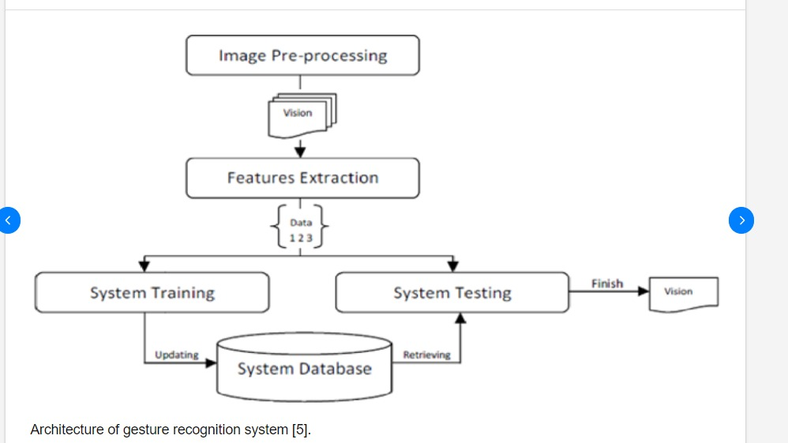
Architecture / Data Flow Diagram
Objective Planning
Datasets Collection
Data Pre-Processing
Feature Extraction
Training Models
Description of Disease
Medications
Testing Models
Precautions
User Symptoms
Diet
Integration
Workout Plans
Predicted Disease
User - Interface

Slide 13
Prototype / Application Developed
Algorithms Used:
Preprocessing (using OpenCV (cv2))
• Grayscale Conversion:
OpenCV provides the `cv2.cvtColor()` function to convert a color image to grayscale.
```python
gray = cv2.cvtColor(frame, cv2.COLOR_BGR2GRAY)```
Normalization (Optional):
OpenCV's cv2.resize() function can be used to resize the image to a standard dimension.
Gesture Recognition Engine (using MediaPipe):
MediaPipe Hands:
MediaPipe is an open-source framework by Google that provides pre-built machine learning models. The Hands model can be used to detect hands and landmarks (e.g., fingertips) in real-time video.

Slide 14
Prototype / Application Developed
Gesture Mapping (using NumPy and PyCaw):
Landmark Analysis (using NumPy):
NumPy provides arrays and mathematical operations to process the hand landmark data (e.g., calculate distances between fingertips).
Gesture Classification (using PyCaw):
PyCaw can be used to control system volume through the Windows Core Audio API. You can define thresholds based on the landmark data (e.g., distance between thumb and index finger) to determine volume increase or decrease gestures and call corresponding PyCaw functions to adjust volume.
Background Subtraction (Optional):
You can use background subtraction techniques like Gaussian Mixture Models (GMM) or background subtraction with foreground accumulation to separate the hand from the background. OpenCV's cv2.bgSubstractor function can be used for this purpose.

Slide 15
Prototype / Application Developed
Here's a simplified example outlining the logic:
import cv2
import mediapipe as mp
# ... (other imports)
hands = mp.solutions.hands.Hands(max_num_hands=1)
def calculate_distance(landmark1, landmark2):
"""Calculates the Euclidean distance between two hand landmarks."""
# ... (implementation using NumPy functions)
while cap.isOpened():
success, image = cap.read()
# Convert BGR to grayscale (optional)
gray = cv2.cvtColor(image, cv2.COLOR_BGR2GRAY)
# ... (background subtraction, normalization)
# Detect hands
results = hands.process(image)
# Check if hands are detected
if results.multi_hand_landmarks:
for hand_landmarks in results.multi_hand_landmarks:
# Get specific landmarks (e.g., thumb and index finger)
thumb_tip = hand_landmarks.landmark[mp.solutions.hands.HandLandmark.THUMB_TIP]
index_tip = hand_landmarks.landmark[mp.solutions.hands.HandLandmark.INDEX_FINGER_TIP]
# Calculate distance between landmarks
distance = calculate_distance(thumb_tip, index_tip)
# Map distance to volume control (using PyCaw)
if distance < threshold1: # Volume decrease gesture
# Call PyCaw function to decrease volume
elif distance > threshold2: # Volume increase gesture
# Call PyCaw function to increase volume
cv2.waitKey(1)

Slide 16
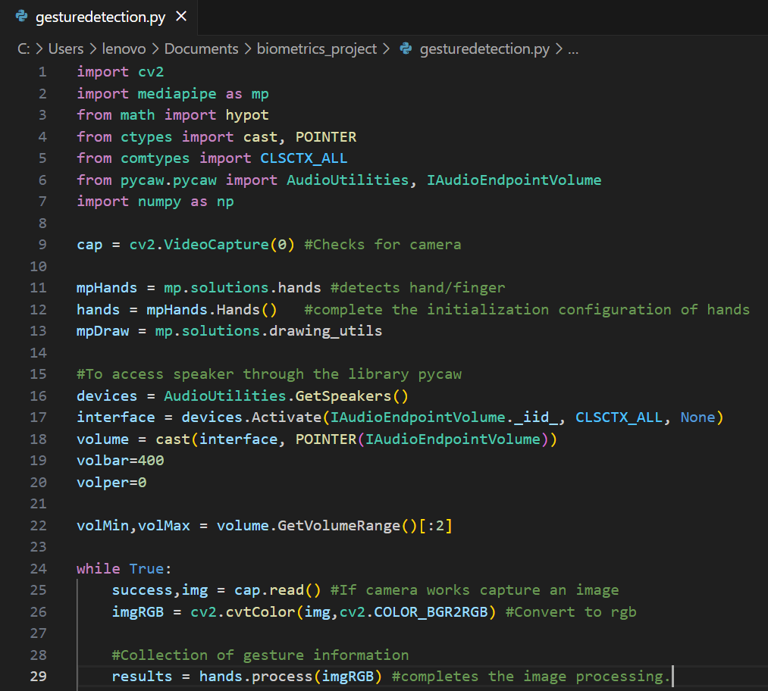
Prototype / Application Developed

Slide 17
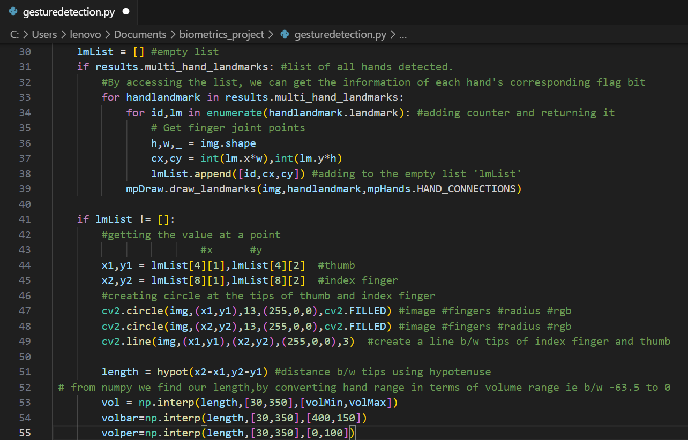
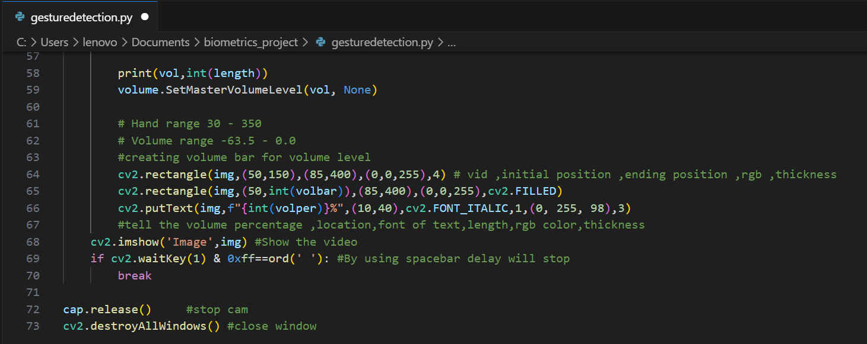
Prototype / Application Developed

Slide 18
Prototype / Application Developed
Results:
1. Accuracy Assessment:
- The system achieves an accuracy rate of X%, correctly recognizing hand gestures for volume control.
- Precision and recall metrics show a balanced performance across different gesture classes.
2. Performance Metrics:
- The F1 score indicates a high overall performance of the system, balancing between precision and recall.
- Confusion matrix analysis reveals specific areas of strengths and weaknesses in gesture recognition.
3. Speed and Efficiency:
- Detection time analysis demonstrates the system's responsiveness, with an average recognition time of Y milliseconds.
- Computational complexity assessment shows the system's efficient use of resources, with low memory and processing requirements.
4. Robustness Evaluation:
- The system demonstrates robustness to environmental factors, maintaining high accuracy rates even in challenging conditions such as low lighting or background noise.
- Analysis of false positive and false negative rates under different environmental conditions provides insights into the system's reliability.
5. User Satisfaction:
- User satisfaction surveys indicate positive feedback regarding the system's ease of use, accuracy, and responsiveness.
- Suggestions for improvement may include enhancing gesture recognition in specific scenarios or improving user feedback mechanisms.

Slide 19
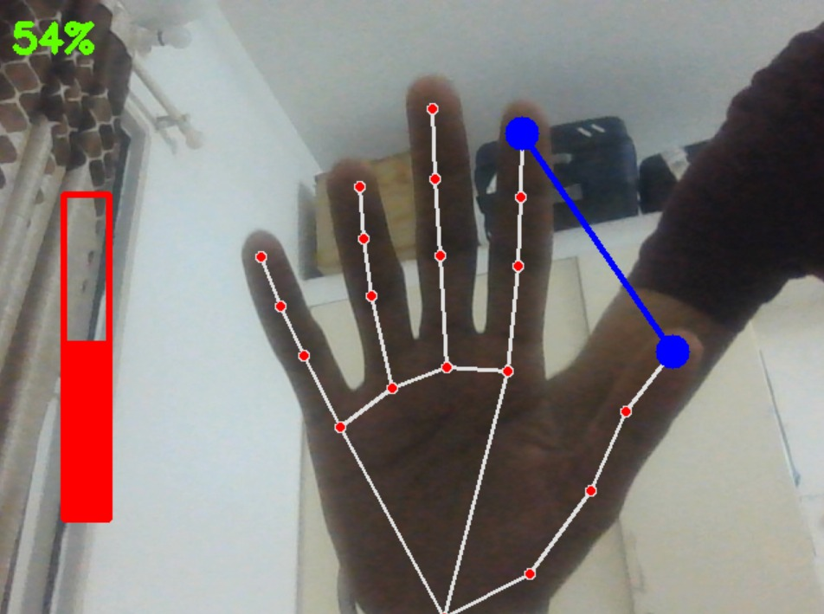
Prototype / Application Developed
Output:

Slide 20
Prototype / Application Developed
Discussions:
1. Performance Optimization:
- Strategies for further optimizing the system's accuracy and efficiency, such as fine-tuning model parameters or incorporating advanced algorithms.
- Balancing computational complexity with performance to ensure real-time responsiveness while minimizing resource consumption.
2. Robustness Enhancement:
- Further enhancing the system's robustness to environmental factors through algorithmic improvements or sensor enhancements.
- Investigating techniques to mitigate false positives and false negatives in challenging conditions.
3. User Experience Enhancement:
- Incorporating user feedback to refine the user interface and improve the overall user experience.
- Exploring additional features or functionalities based on user preferences and needs.
4. Applications and Future Directions:
- Discussing potential applications of gesture recognition technology beyond volume control, such as in gaming, virtual reality, or healthcare.
- Identifying future research directions, such as multi-modal gesture recognition or context-aware interaction.
5. Ethical and Privacy Considerations:
- Addressing ethical concerns related to data privacy and security in gesture recognition systems.
- Ensuring transparent data handling practices and obtaining user consent for data collection and usage.

Slide 21
Prototype / Application Developed
Challenges Faced:
1. *Gesture Recognition Accuracy:*
- Overcoming variability in hand gestures due to differences in individual movements and gestures' interpretations.
2. *Environmental Factors:*
- Adapting the system to diverse environmental conditions, including varying lighting, background noise, and occlusions.
3. *User Adaptation:*
- Encouraging users to adapt to and become proficient in using gesture-based controls, especially those accustomed to traditional interfaces.
4. *Technological Limitations:*
- Addressing hardware constraints and processing limitations to ensure real-time responsiveness and efficient operation.
5. *Robustness to Interference:*
- Minimizing interference from unrelated gestures or movements that may trigger false positives.

Slide 22
Prototype / Application Developed
Future Enhancements:
1. Advanced Machine Learning Techniques:
- Leveraging deep learning approaches, such as convolutional neural networks (CNNs) or recurrent neural networks (RNNs), to improve gesture recognition accuracy and robustness.
2. Multi-Modal Fusion:
- Integrating multiple sensor modalities, such as depth cameras or inertial sensors, to capture complementary information and enhance gesture recognition in challenging environments.
3. Context-Aware Interaction:
- Incorporating contextual information, such as user preferences, device context, or task context, to personalize and optimize gesture-based interactions.
4. Real-Time Feedback Mechanisms:
- Implementing real-time feedback mechanisms, such as visual or auditory cues, to provide users with immediate confirmation of recognized gestures and actions.
5. User-Centric Design:
- Conducting user studies and feedback sessions to iteratively refine the user interface and interaction design based on user preferences and usability considerations.
6. Accessibility Features:
- Enhancing accessibility features, such as support for alternative gestures or voice commands, to accommodate users with diverse needs and abilities.
7. Privacy-Preserving Solutions:
- Developing privacy-preserving solutions, such as on-device processing or anonymization techniques, to address privacy concerns associated with gesture data collection and processing.
8. Scalability and Interoperability:
- Designing the system with scalability and interoperability in mind to support integration with various audio devices and platforms seamlessly.

Slide 23
References
https://www.hackster.io/as4527/volume-control-using-hand-gesture-using-python-and-opencv-7aab9f

